Slide 1
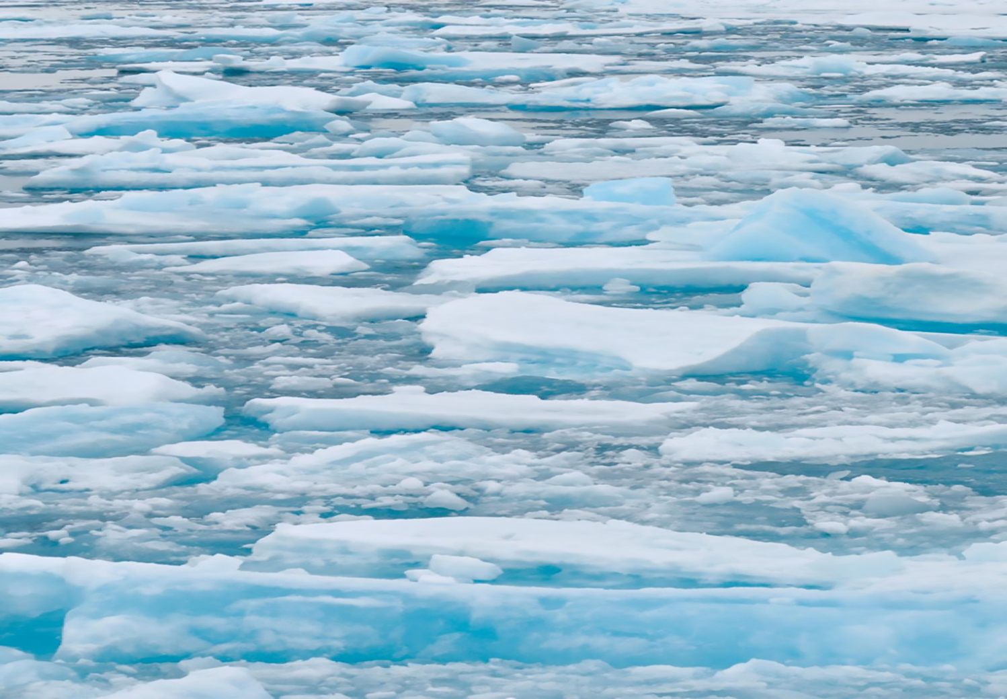
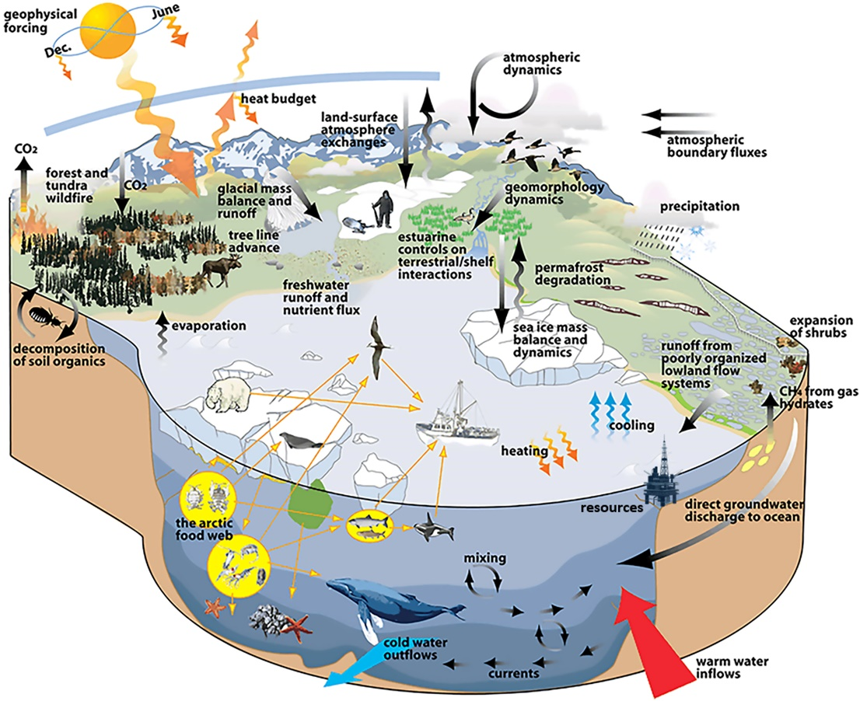
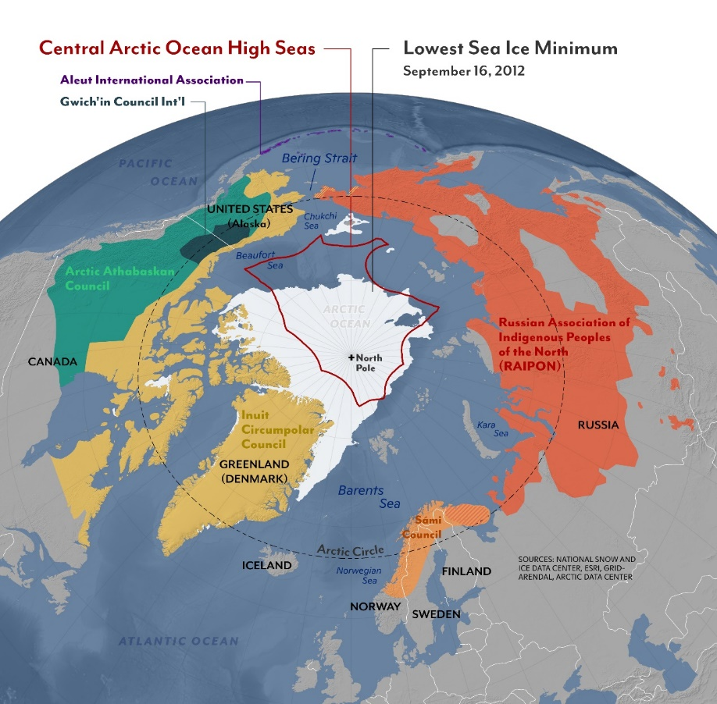
Interagency Arctic Research Policy Committee (IARPC) – 6 December 2023
Arctic Satellite Knowledge (ASK):
Integrating Maritime Ship Traffic
Who is involved with the Arctic system?
When are the urgencies of the Arctic system?
Why to we need to sustain the Arctic system?
What is the Arctic system?
Where are the boundaries of the Arctic system?
How do we manage the Arctic system?
Prof. Paul Arthur Berkman
pab@scidiplo.org | paul.berkman@unitar.org

Slide 2
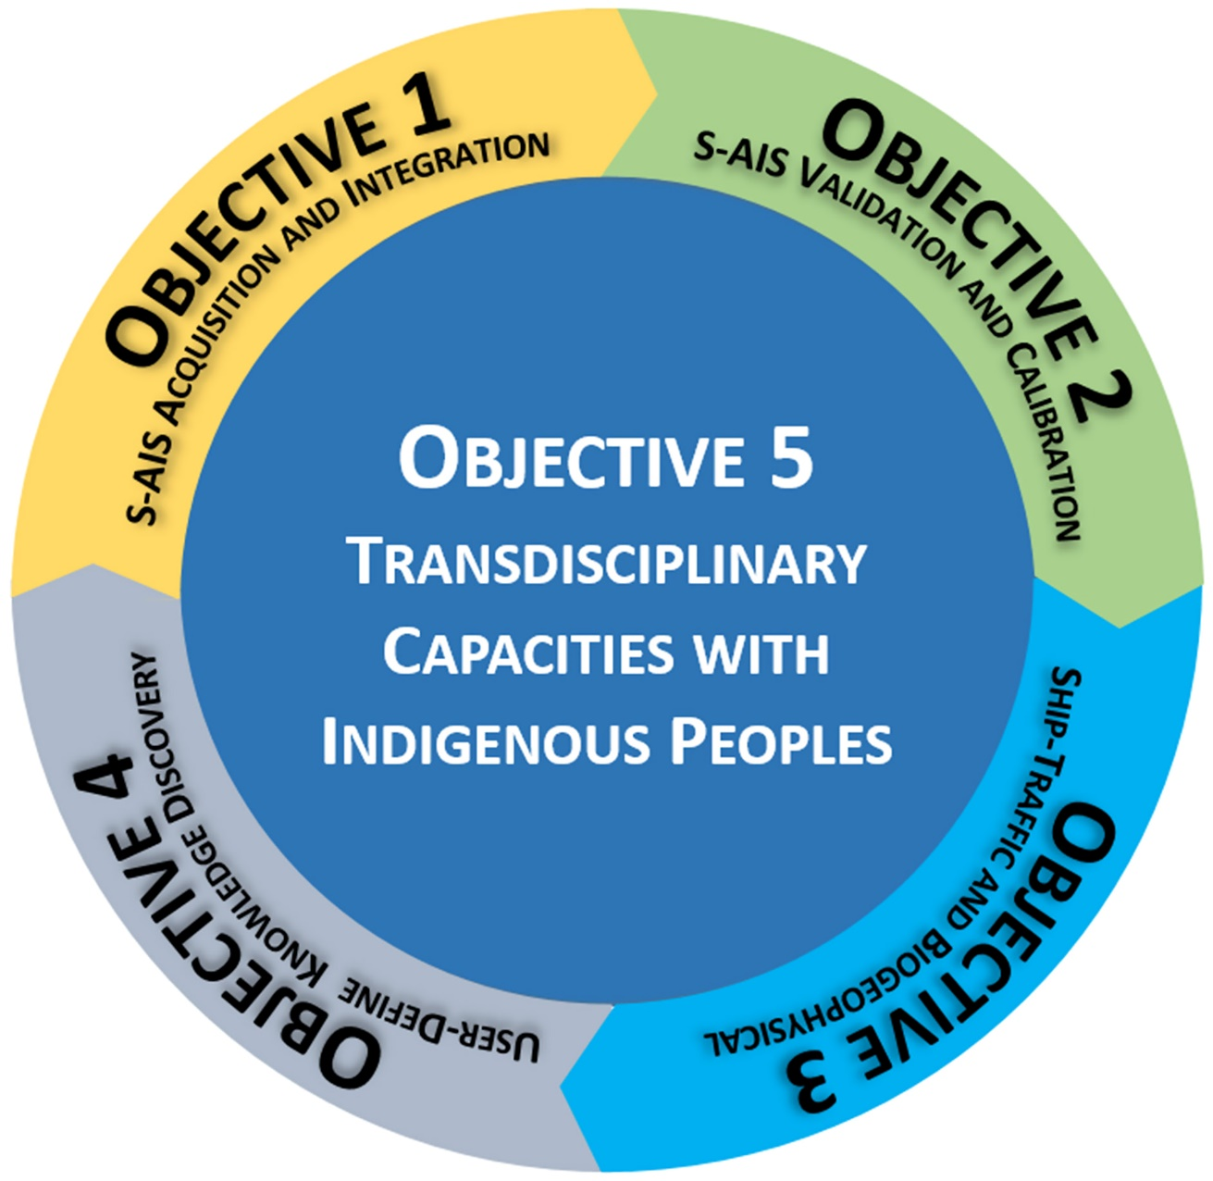
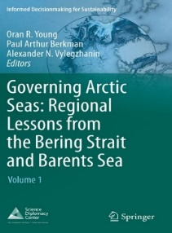
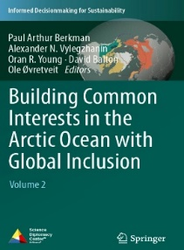
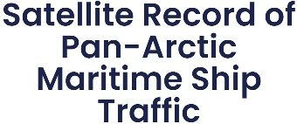
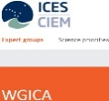
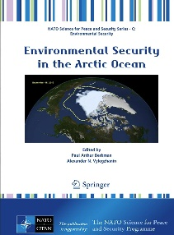
ASK – A Brief History
2023-2028
2013-2022
Transdisciplinary Cycle of ASK Project Objectives and Tasks
Proposed with the Arctic Observing Network (AON) and Arctic Research Coordination and Policy Support (ARCPS) Programs, NSF Office of Polar Programs
Arctic Options / Pan-Arctic Options Projects (2013-2022):
Holistic Integration for Arctic Coastal-Marine Sustainability
(United States, Russia, Norway, France, China and Canada)
2022
2020
2022
2022
2020
3 November 2017 VOL 358 ISSUE 6363 sciencemag.org SCIENCE
Governing the Bering Strait Region:
Current Status, Emerging Issues and Future Options.
Ocean Development and International Law. 2016 Volume 47:186-217.
By Paul Arthur Berkman
March 12, 2013
2009-2012
First S-AIS data
North of the Arctic Circle
1 September 2009
2012

Slide 3
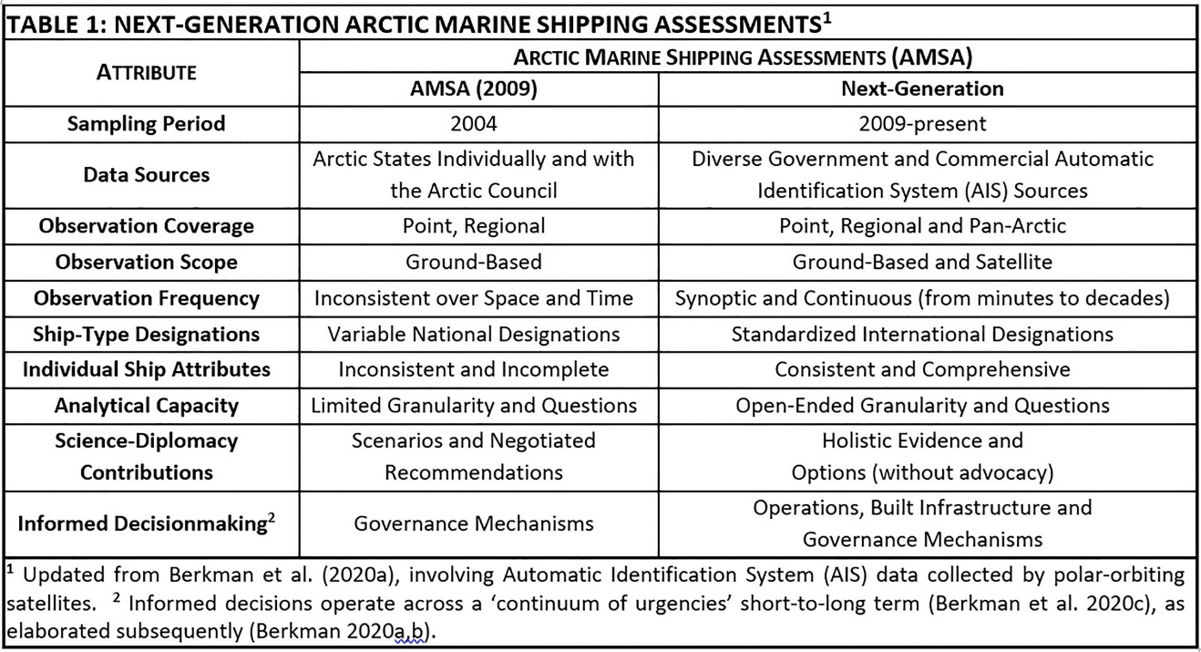
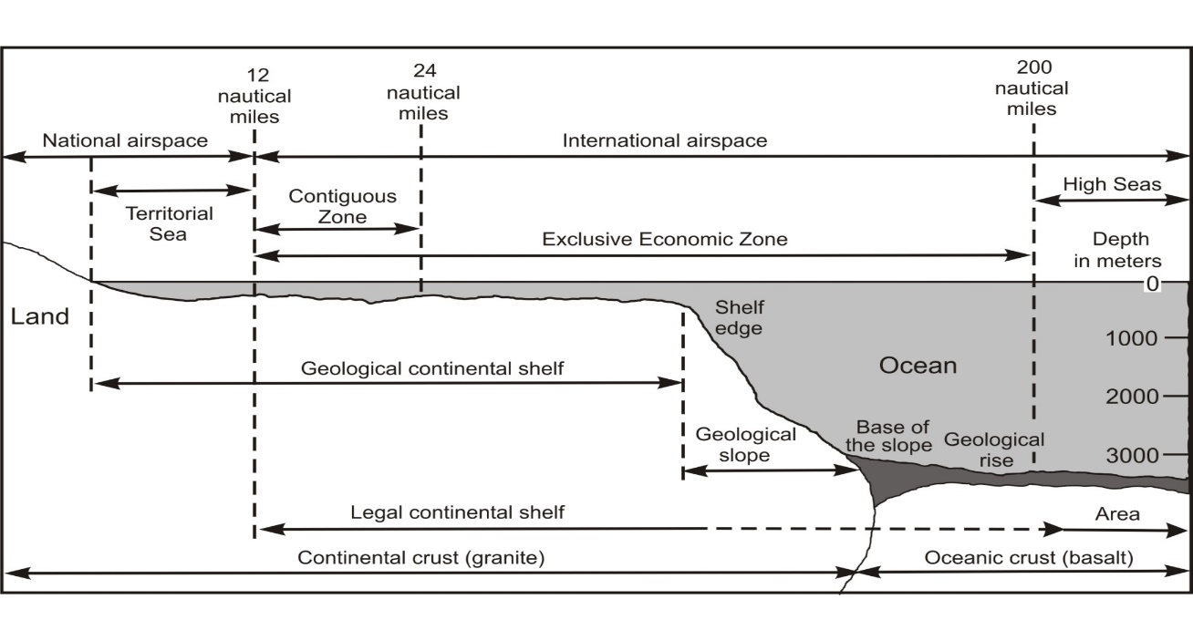
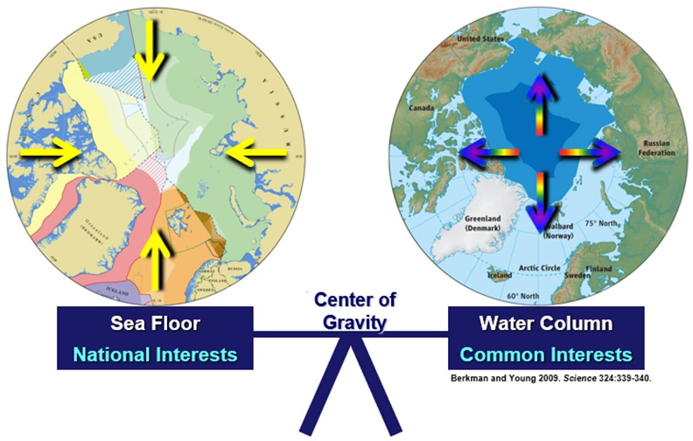
Satellite Automatic Identification System (S-AIS) Data
Arctic Options / Pan-Arctic Options Projects (2013-2022):
Holistic Integration for Arctic Coastal-Marine Sustainability
(United States, Russia, Norway, France, China and Canada)
“We remain committed to the framework of the Law of the Sea…”
(Arctic Council. 2013. Vision for the Arctic)
National Interests Common Interests

Slide 4
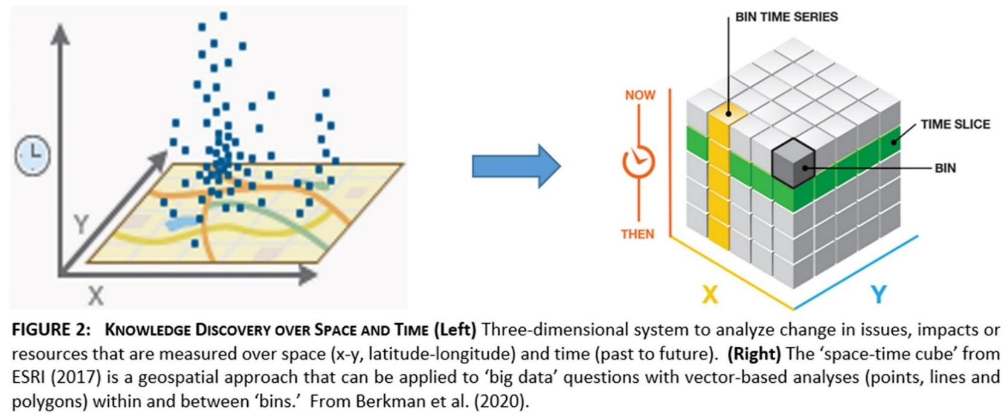
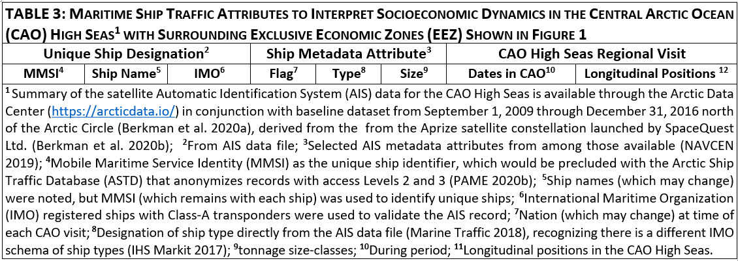
Integrating Maritime Ship Traffic over Space and Time
173,000,000 S-AIS records with 21,005 unique ships during 2009-2018

Slide 5
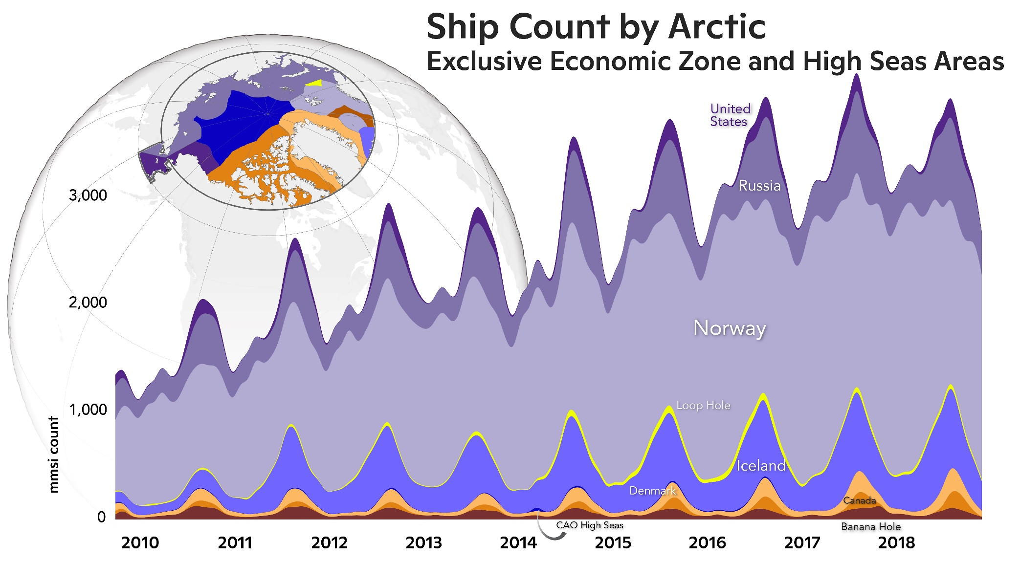
Circumpolar Distribution of Maritime Ship Traffic
Within Law of the Sea Zones North of the Arctic Circle
Biogeophysical
Socio-Economic

Slide 6
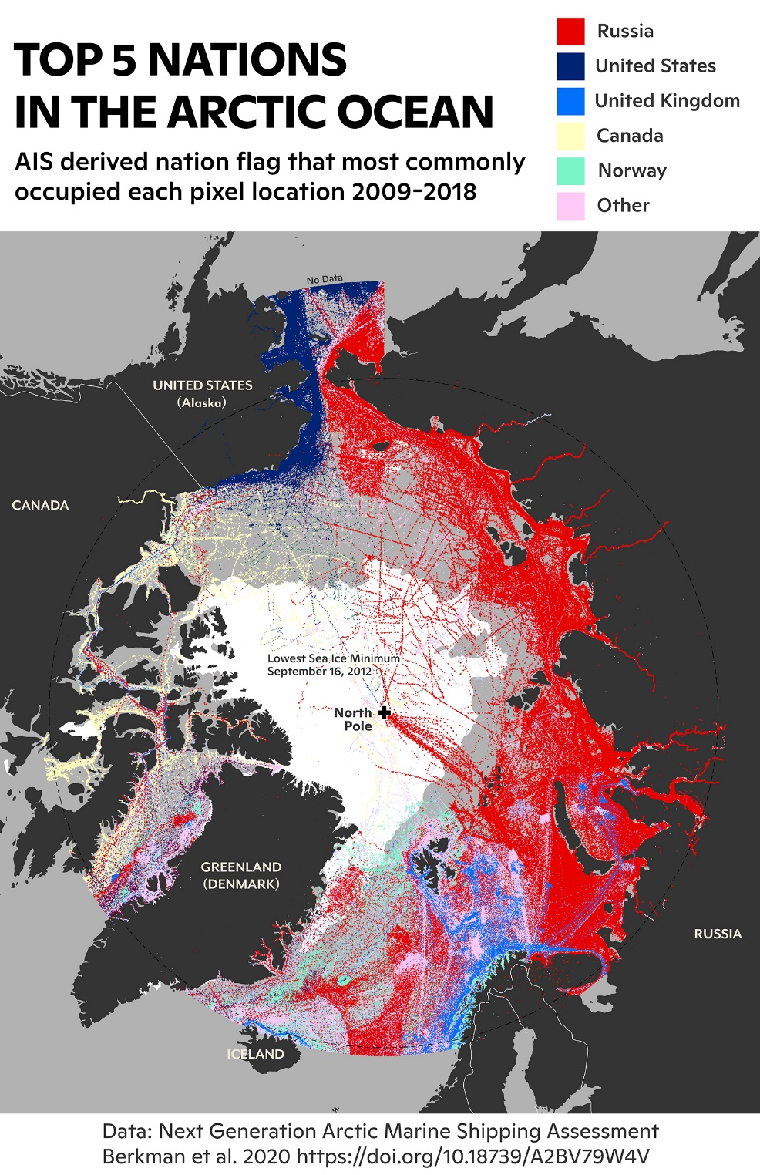
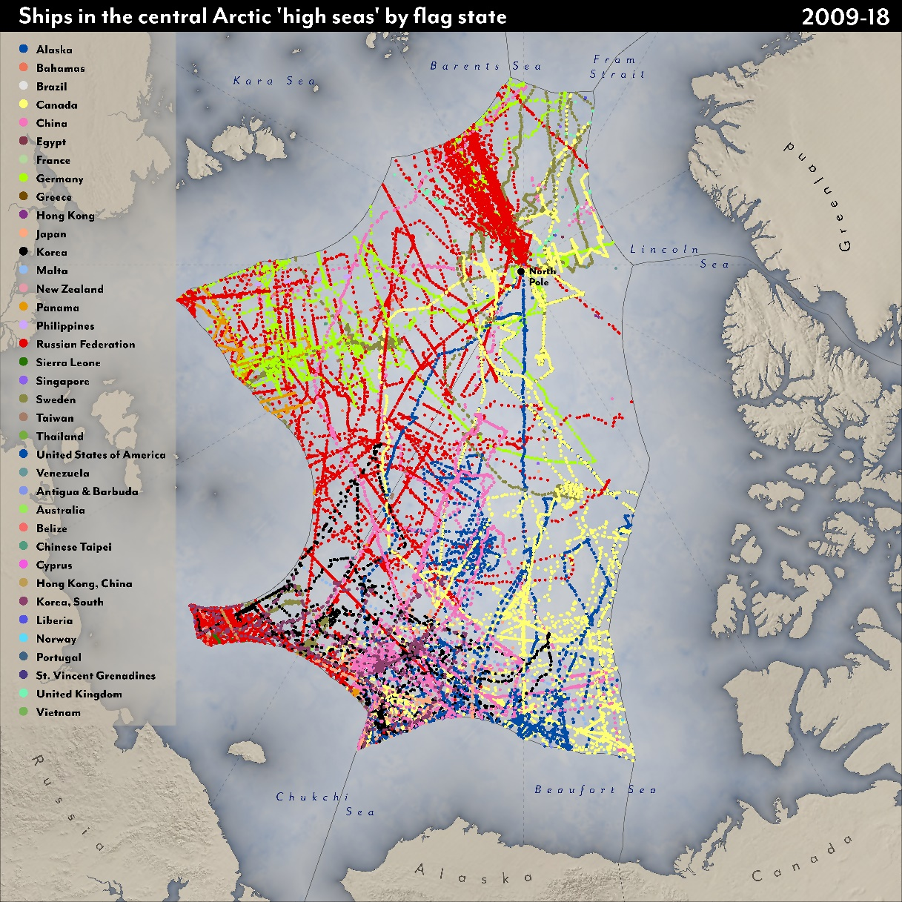
Arctic Maritime Ship Traffic Community by Nations
Ships in the Central Arctic Ocean (CAO) High Seas by Flag State 2009-2018

Slide 7
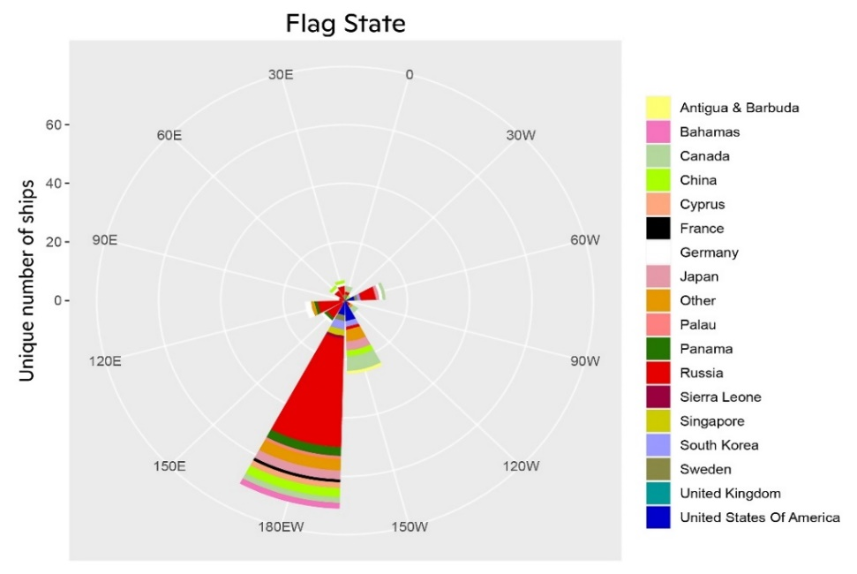
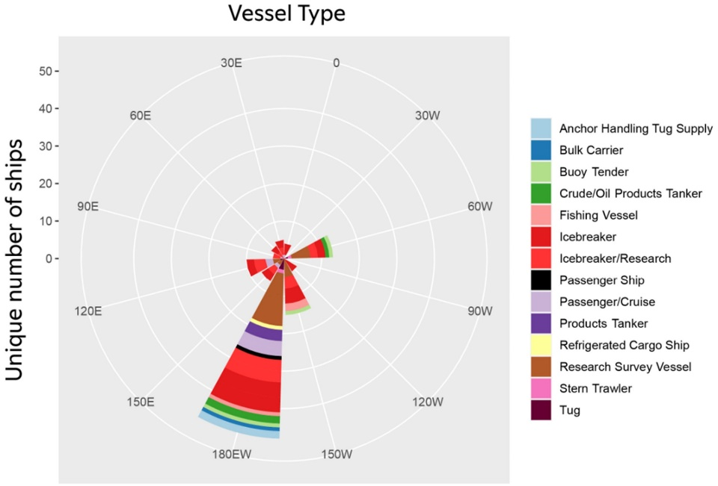
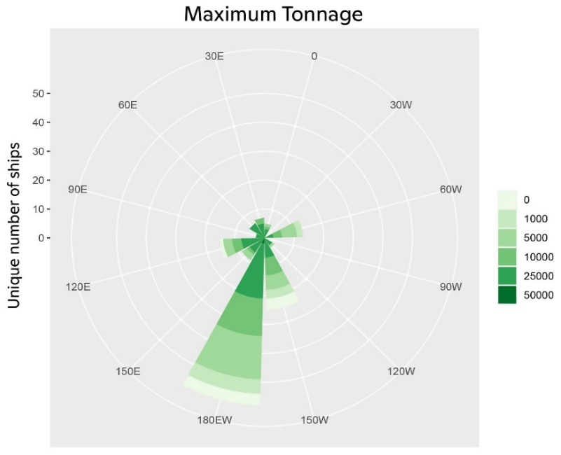
Ship Traffic Into the CAO High Seas (2009-2018):
Predominates from the Pacific Sector

Slide 8
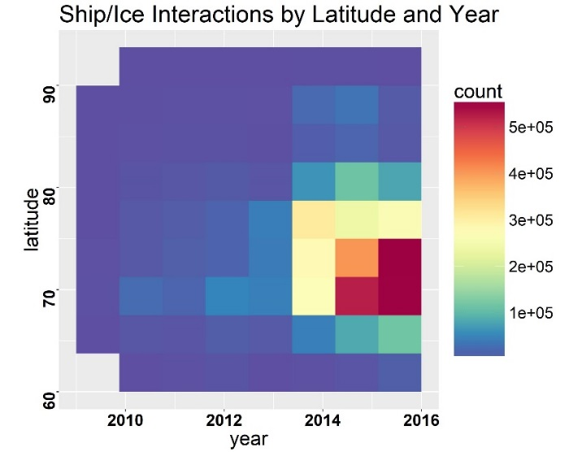
Pan-Arctic Observational Integration with Maritime Ship Traffic
Testing the ‘Ship-Ice Hypothesis’
“Arctic ship traffic is increasing as sea-ice is diminishing”
(Berkman et al. 2020a, 2022a,b)

Slide 9
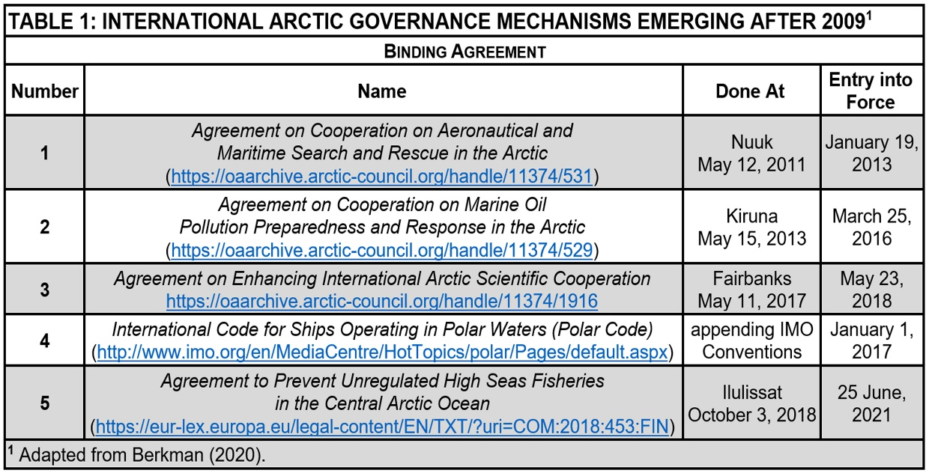
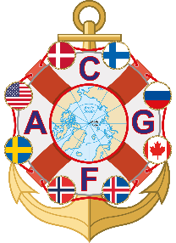
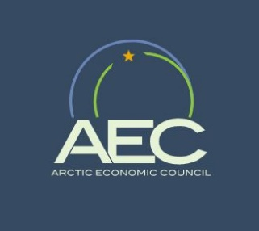
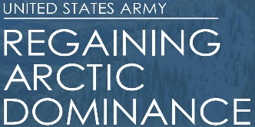
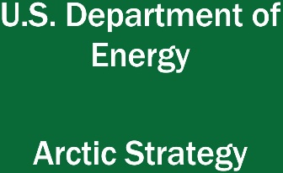
Pan-Arctic Transdisciplinary Integration with Maritime Ship Traffic
“The United States seeks an Arctic region that is peaceful, stable, prosperous, and cooperative.”

Slide 10
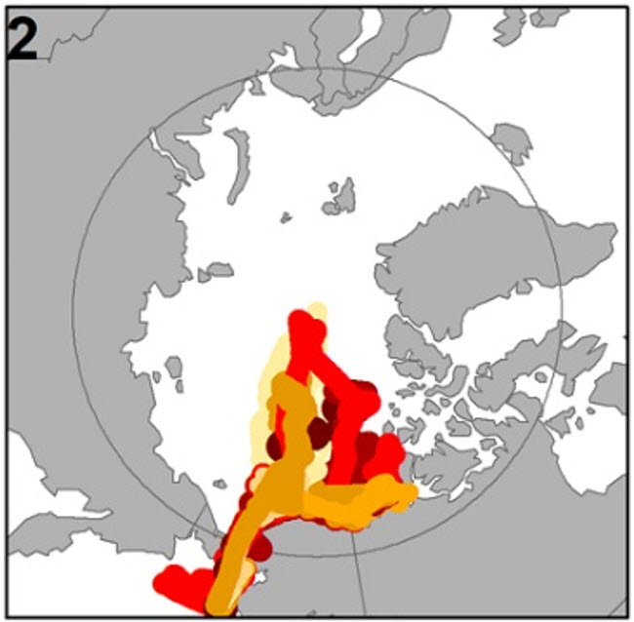
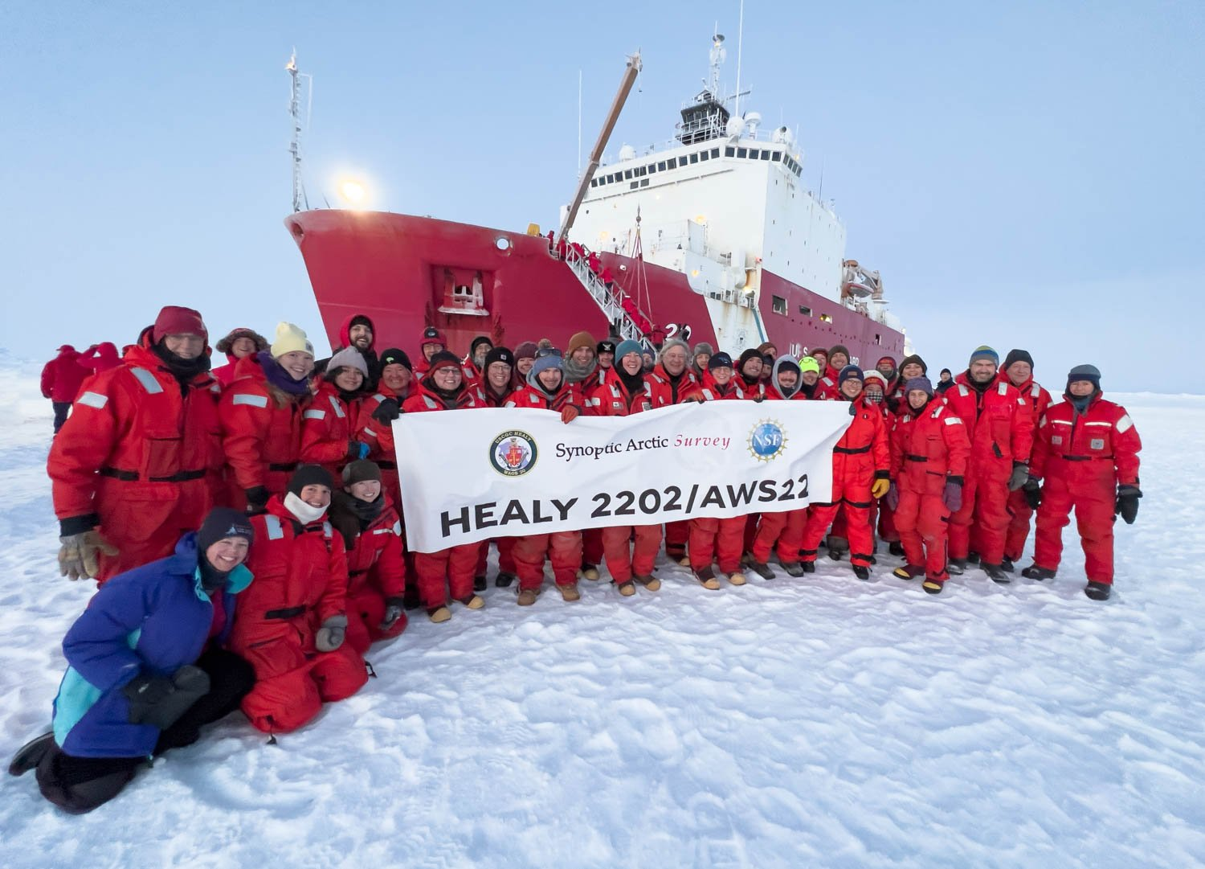
What Questions do you want to ASK?
‘Healy’ – Arctic 2009-2016
Lydia Ames / Leonard Sussman

